Slide 1
BPMN and i*
Business Process Management

Slide 2
Introduction
Business process models play a key role in both organizational management and enterprise information systems development.
Many notations developed for the task of modeling business processes, have their own focus of application and appropriate audience.
Some of the most prominent modeling notations enlisted are focused towards technically-oriented data, and process modeling notations such as ER, Data-Flow, Systems Flowcharting and UML and workflow modeling.

Slide 3
Background
The notations used for modeling business processes have been categorized in many ways, based on their conceptual features.
The common principle recognized in all analyses is that some notations are more suited towards specific audiences (i.e. with either technical/non-technical backgrounds) or applications.
i* supports modeling rich organizational contexts by offering high-level social abstractions (such as goals, tasks, soft goals and dependencies) as modeling constructs for reasoning support during business process redesign

Slide 4
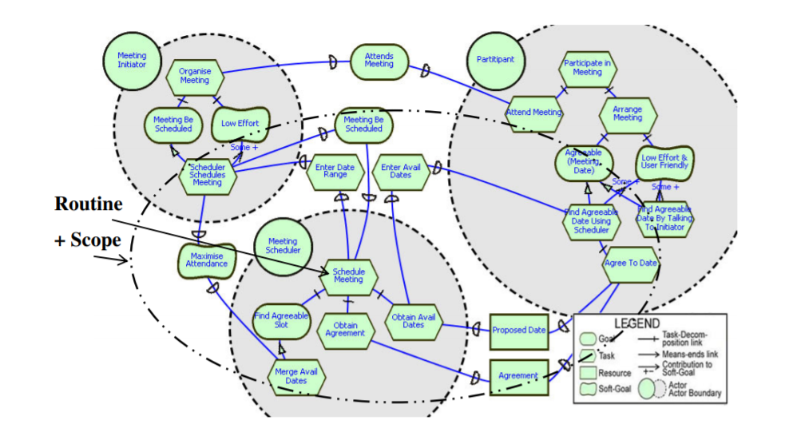
Organizational model
Figure 1 represents a simple i* Meeting Scheduling model

Slide 5
Business Process Modeling Notation (BPMN)
The Business Process Modeling Notation (BPMN), developed by the Business Process Management Initiative (BPMI.org) is primarily a technically-oriented business process modeling notation that supports the assignment of activity execution control to entities within an organization via ‘swim-lanes’.

Slide 6
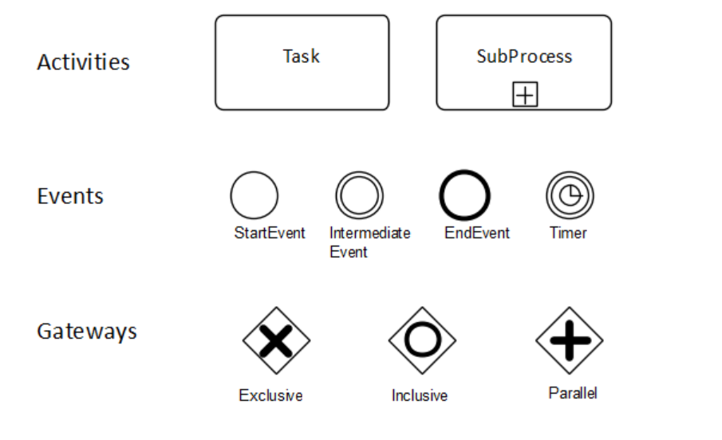
bpmn notation symbols

Slide 7
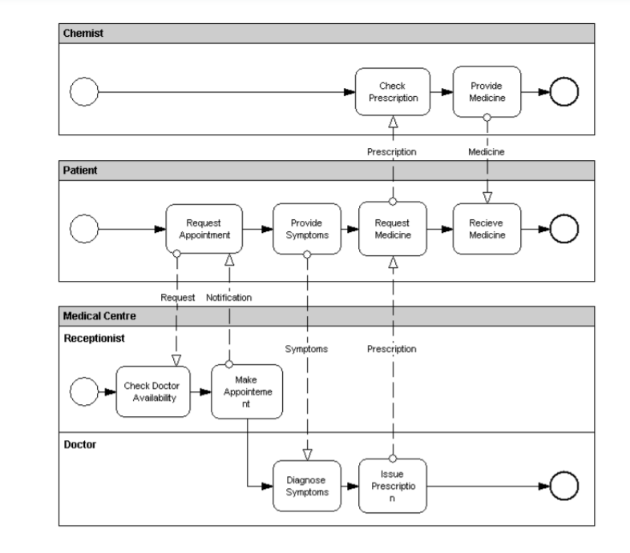
BPMN Example

Slide 8
Correlation
The concept of Correlation facilitates the association of a Message to a Send Task or Receive Task1 often in the context of a Conversation, which is also known as instance routing.
Correlations can be used to specify Conversations between Processes that follow a fairly simple Conversation pattern.
The correlation itself is defined in terms of correlation fields, which denote a subset of the conceptual data that should be used for the correlation. (For example, if the conceptual data comprises an order, then the correlation field might be denoted by the order ID).

Slide 9
Software Used
Lucidchart
Camunda
HEFLO
Visual Paradigm

Slide 10
References
1. Smith, H. Fingar, P.: Business Process Management – The Third Wave. Meghan-Kiffer Press, Tampa Florida (2003) 2. Hammer, M. Champy, J.
Reengineering the Corporation: A Manifesto for Business Revolution. HarperBusiness, (1993)

Slide 11
Phase | How CM can contribute to the phase | Suggested Grammar
Business Understanding | Represent, abstract domain, identify boundary objects | i*, BPMN, UML, BIM
Data Understanding | Modeling scripts, extending | ER, UML
Data Preparation | Attribute selection, cleaning, transformation | BPMN, EPCs
Modeling | Representation of domain models | UML, ERD
Evaluation | Transparency, Understandability | UML, ERD, BIM, Enterprise model
Deployment | Documentation | i*, BPMN, UML

Slide 13


Slide 14


Slide 15


Slide 16


Slide 17


Slide 18


